Slide 1
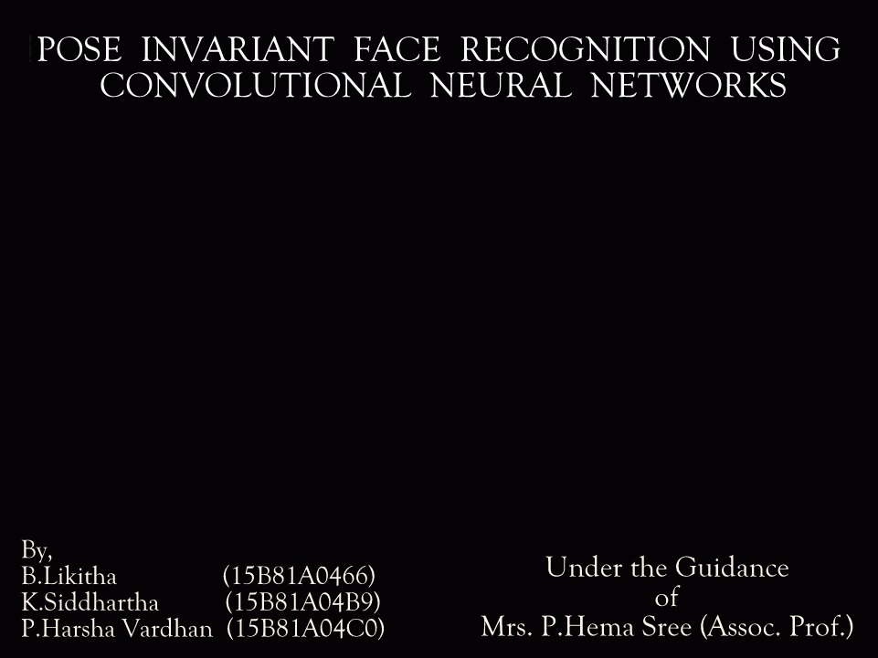
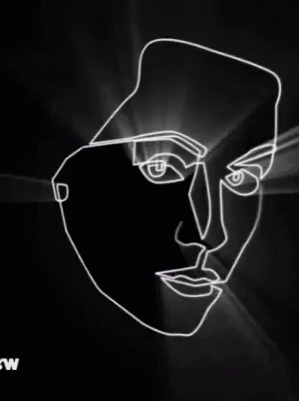
Batch Number
B9

Slide 2
Contents
Motivation
Abstract
Objective
Project Flow
Literature Survey
Problems Faced in Face Recognition
Pose Variation
Illumination
Occlusions
Facial Expressions
Block Diagram
CNN
Various Layers in CNN
Databases Used in the Project
Training Results
Testing Results
Alternative Methods
Tools & Libraries Used
Hardware Comparison
Comparison of Various CNN Models
Future Scope and Conclusion

Slide 3
Motivation
The problem of automatic face recognition is to visually identify a person in an input image. This task is performed by matching the input face against the faces of known people in a database of faces.
Most existing work in face recognition has limited the scope of the problem, however, by dealing primarily with frontal views, neutral expressions, and fixed lighting conditions.
To help generalize existing face recognition systems, we look at the problem of recognizing faces under a range of viewpoints.

Slide 4
Abstract
This abstract aims at the development of a robust face recognition system which is suitable in identifying faces irrespective of various alignments or poses of the face. Most of the existing algorithms in face detection are only successful in controlled environments and fail drastically when non linear functions such as pose variation, illumination and occlusion are affecting the image.
Convolutional Neural Networks is used in applying feature extraction to normalize the data causing the system to cope with faces subject to pose variation.

Slide 5
Objective
The objective of this work principally concerns the evaluation of Convolutional Neural Networks (CNN) in the context of facial analysis applications. More specifically, we will focus on the following objectives:
Evaluate the performance of CNNs w.r.t. appearance-based facial analysis.
Investigate the robustness of CNNs against classical datasets like FERET, ATT, WEBCAM, etc.
Propose different CNN architectures designed for specific problems.
Extend the project to single sample based pose invariant face recognition.

Slide 6
Project Flow
Study on Existing Methods and Algorithms based on Face Recognition
Detailed Study on Uncontrollable Factors Affecting Face Recognition
Selecting Pose Variation Problem as Main Domain
Learning about CNN and Various Layers in it
Choosing Ideal CNN Parameter to Overcome Pose Variation Problem
Testing Various Databases and Creating an Analogy Between them
Comparing Speed of the Architecture on Various Hardware
Alternative Methods to Reduce Time Complexity

Slide 7
Literature Survey
SVM Based Face Recognition
PCA Based Face Recognition
HOG Features
Sparse Representation Based Classification
Artificial Neural Networks
Deep Learning / Deep Neural Networks
Convolutional Neural Networks

Slide 8
Problems Faced In Face Recognition
Pose Variation
Illumination
Occlusions
Facial Expressions

Slide 9


Examples of Pose Variations

Slide 10
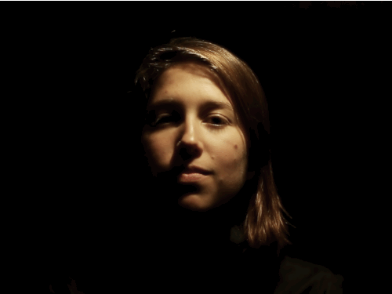
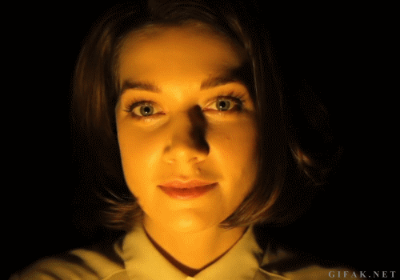
Examples of Illumination

Slide 11

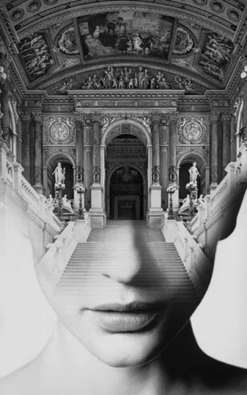
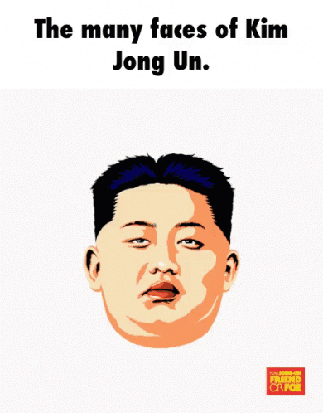

Examples of Occlusions

Slide 12

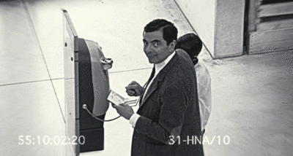
Examples of Facial Expressions

Slide 13
CNNs
Neural as the name suggests, they are brain inspired systems which are intended to replicate the way we humans learn.
Neural networks consist of input and output layers as well as hidden layers consisting of units that transform the input into output.
There are many layers inside the architecture which are helpful in extracting various features from the input image, i.e., ConvNets are feature extractors.
The deeper you go into the network, the complex these feature extractors become.

Slide 14
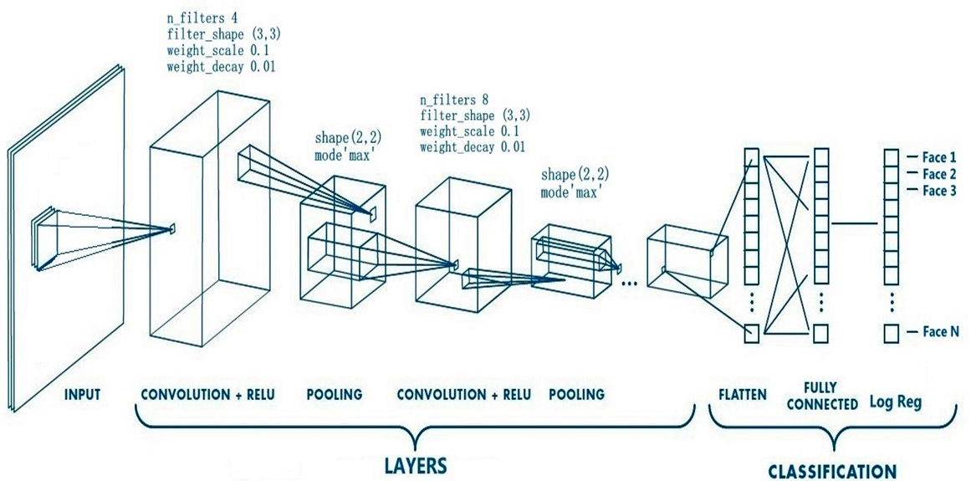
Block Diagram of Convolutional Neural Network & Architecture

Slide 15
Various Layers in the Architecture
Convolutional Layer
Activation Layer
Pooling Layer
Classifiers
Linear Classifier
Log Regression

Slide 16
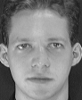




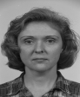




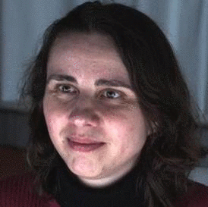
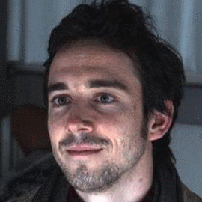

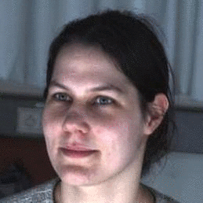

Databases Used in the Project
ATT Database
FERET Database
WEBCAM Database

Slide 17
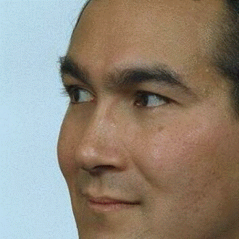
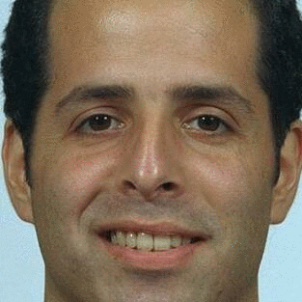
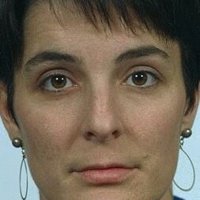
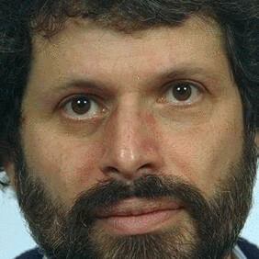
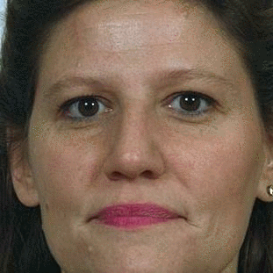



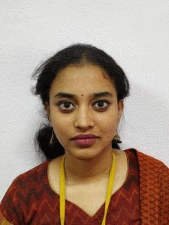

Databases Used in the Project
Pose Database
OWN Database

Slide 18
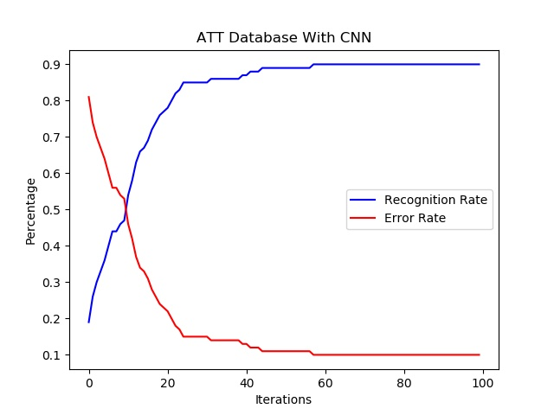
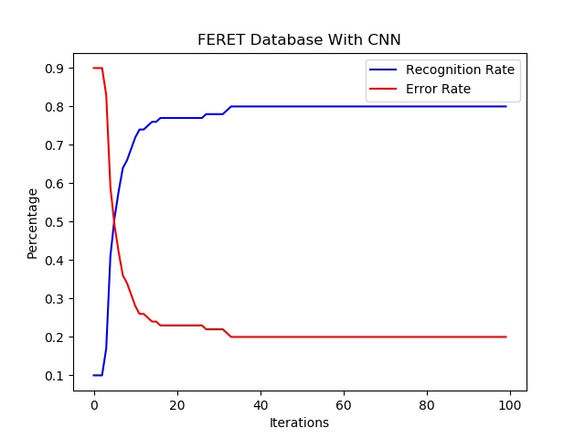
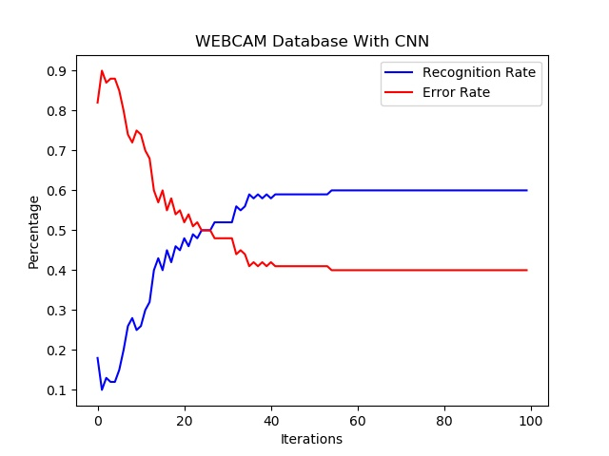
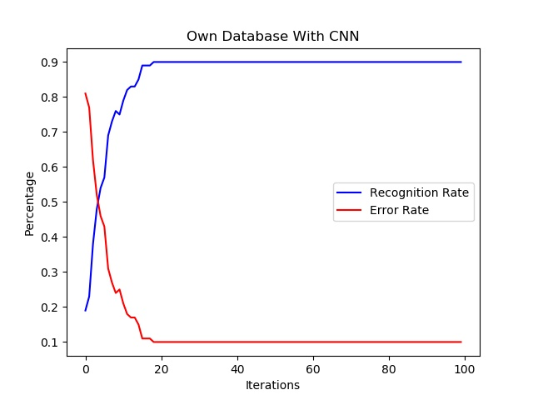
Training Results

Slide 19
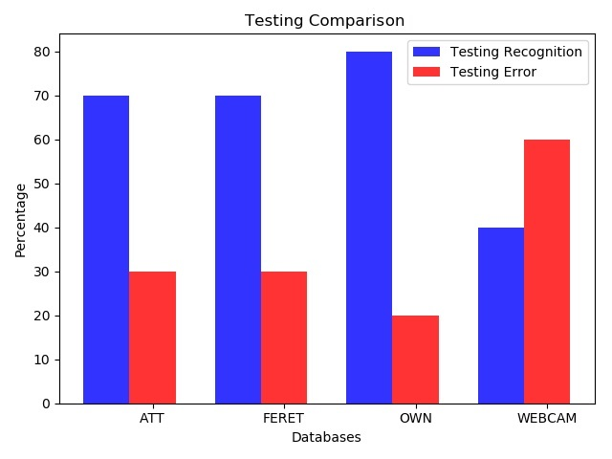
Testing Results

Slide 20
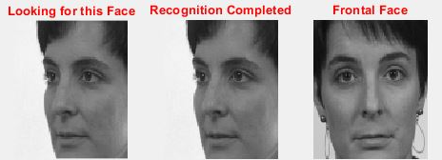
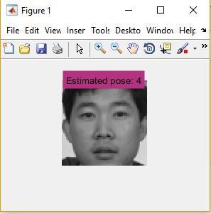
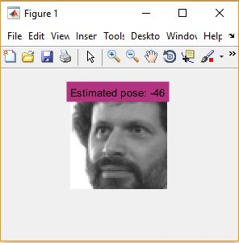
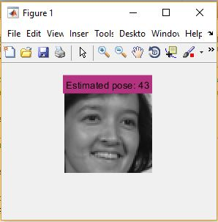
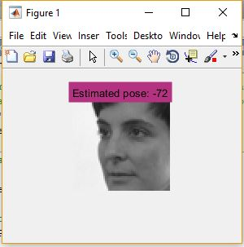
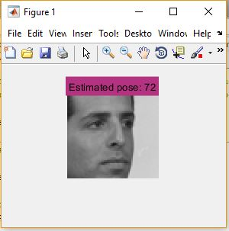
Alternative Methods
CNN and other neural networks are often time consuming but they provide accurate results. Thus, we can go for alternative methods like Pose Invariant PCA or Pose Estimator which are quite fast.
Output of PCA
Output of Pose Estimator

Slide 21
Advantages
We used CNN (Convolutional Neural Networks) in building this system which is more efficient in extracting the features from picture.
We reduce the size of intermediate images required for processing in CNN.
We will be able to produce accurate output with less number of data sets in this system.

Slide 22
Tools & Libraries Used
Python
OpenCV
Numpy
Scipy
Matplotlib
Google Colaboratory
Irfan View

Slide 23
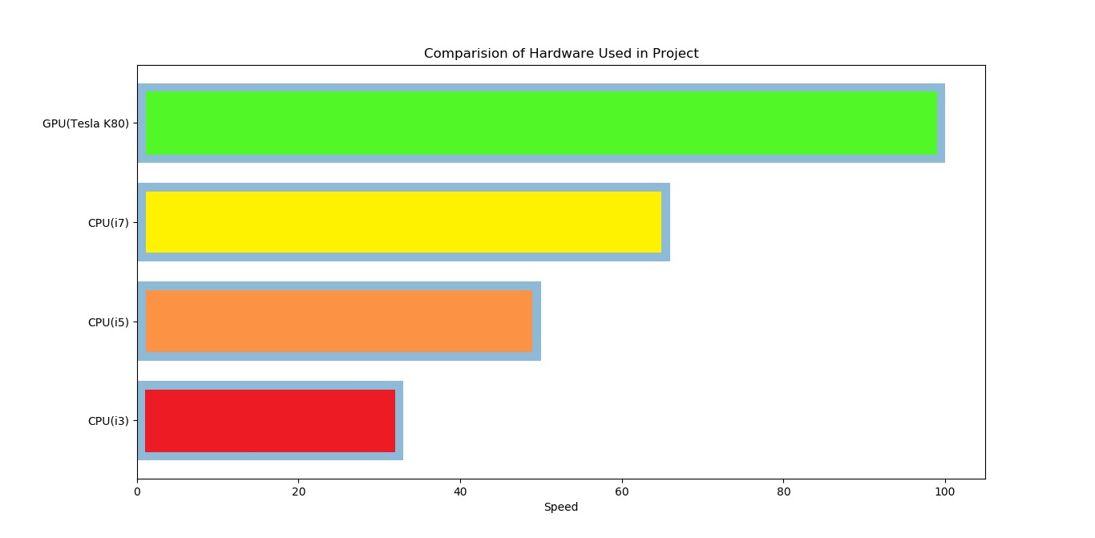
Hardware Comparison

Slide 24
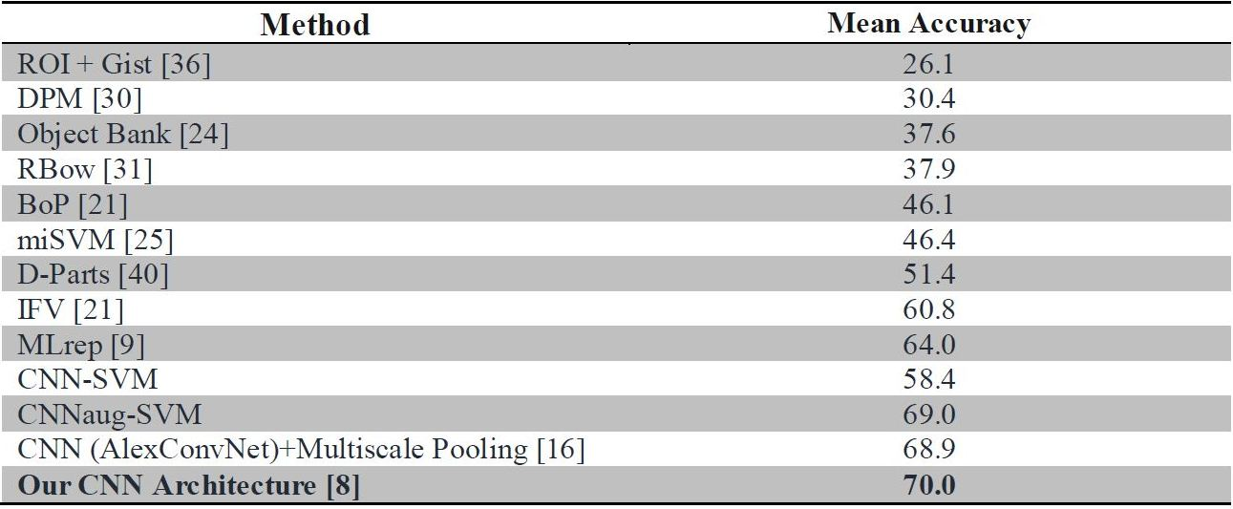
Comparison of Various CNN Models

Slide 25
Conclusion
In this thesis, various approaches to classify the poses of different face images are proposed and investigated. The experimental results show that CNN has the capability to capture the semantic contents from the image spectra.
The proposed approaches provide a novel framework for pre-processing steps prior to image classification. The proposed techniques are evaluated through extensive simulations on large standard databases of different categories of pose invariant facial images. The enormous scope of spectra of pose invariant facial images is analyzed.
Although great progress in PIFR has been achieved, there is still much room for improvement, and the performance of existing approaches needs to be further evaluated on real-world databases.

Slide 26
Future Scope
Besides obtaining a robust technique like CNN to classify pose variations in facial images, we are also trying to incorporate volumetric regression so that we can generate different poses with single image and then train them using the proposed architecture.
Since we know that the problems and challenges faced in facial recognition are inevitable, we were specifically dealing only with poses in this project. But in the near future we can expect many more advancements in this field considering the rapid growth in the field of Machine Learning.
CNN can also be used for large-scale video classification.
Besides CNN, Deep learning techniques like Recurrent Neural Networks can be used to over come various non linear factors affecting face recognition.

Slide 27
References
G. Arulampalam and A. Bouzerdoum. A generalized feedforward neural network architecture for classification and regression. Neural Networks, 16:561–568, 2003.
S. O. Ba and J. M. Odobez. A probabilistic framework for joint head tracking and pose estimation. In Proceedings of the 17th International Conference on Pattern Recognition, volume 4, pages 264–267, August 2004.
Face Image Analysis with Convolutional Neural Networks Stefan Duffner Master of Science Thesis in Electrical Engineering Face Recognition with Preprocessing and Neural Networks David Habrman 2007.
Pose-invariant Face Recognition by Matching on Multi-resolution MRFs linked by Supercoupling Transform Shervin Rahimzadeh Arashloo, Josef Kittler and William J. Christmas.
A Comprehensive Survey on Pose-Invariant Face Recognition Changxing Ding Dacheng Tao Centre for Quantum Computation and Intelligent Systems, Faculty of Engineering and Information Technology University of Technology,2016.

Slide 28
Disentangled Representation Learning GAN for Pose-Invariant Face Recognition Luan Tran, Xi Yin, Xiaoming Liu Department of Computer Science.
Face Frontalization Using Appearance Flow based Convolutional Neural Network Zhihong Zhang, Xu Chen, Beizhan, Edwin R. Hancock, Fellow, IEEE.
Illumination and Pose Invariant Face Recognition:A Technical Review K. R. Singh.
Logistic Regression and Convolutional Neural Networks Performance Analysis based on Size of Dataset Kartik Chopra, C. Srimathi VIT University.
Pose-Invariant Face Alignment via CNN-Based Dense 3D Model Fitting Amin Jourabloo New York 2017.
Supplementary Material for Large Pose 3D Face Reconstruction from a Single Image via Direct Volumetric CNN Regression Aaron S. Jackson.

Slide 29



